Slide 1
Portfolio Project
By Jim Farrugia

Slide 2
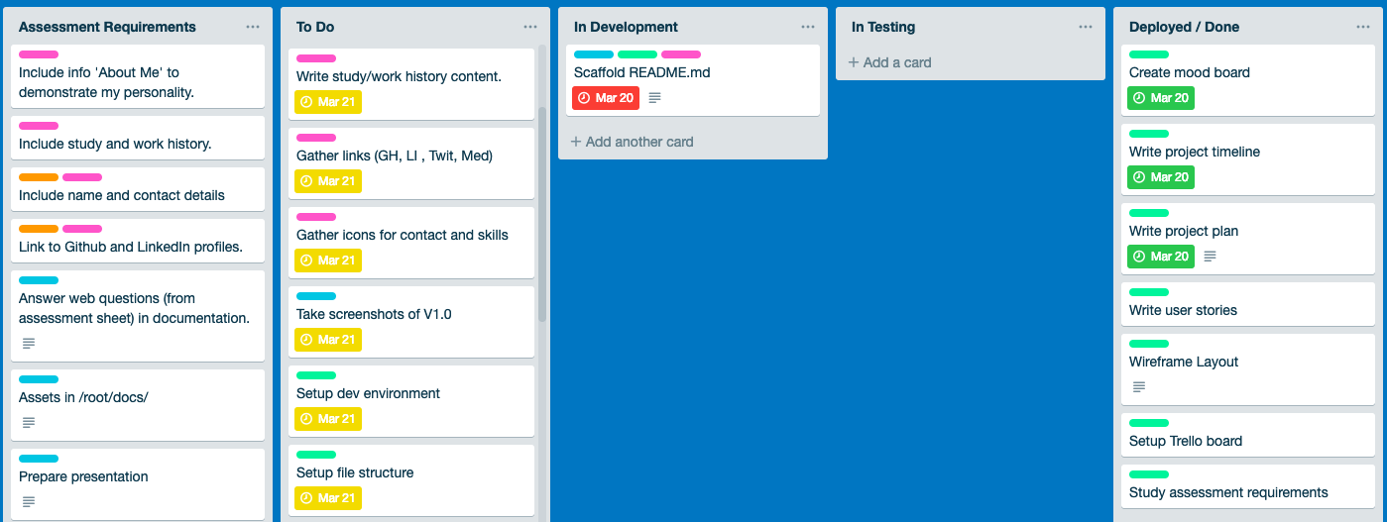
Organising Tasks with Trello

Slide 3
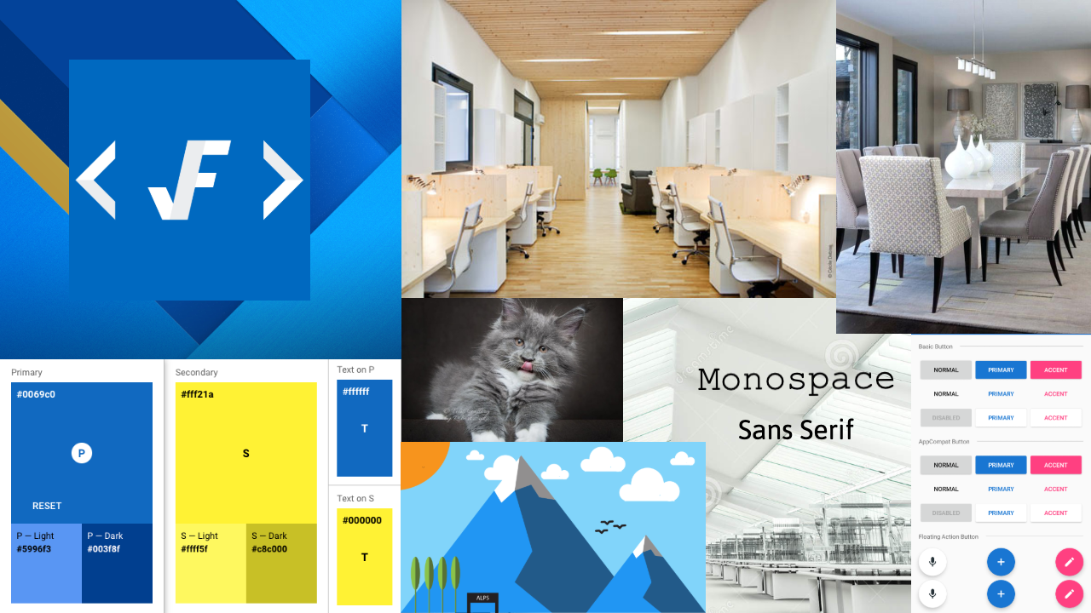
Moodboard

Slide 4
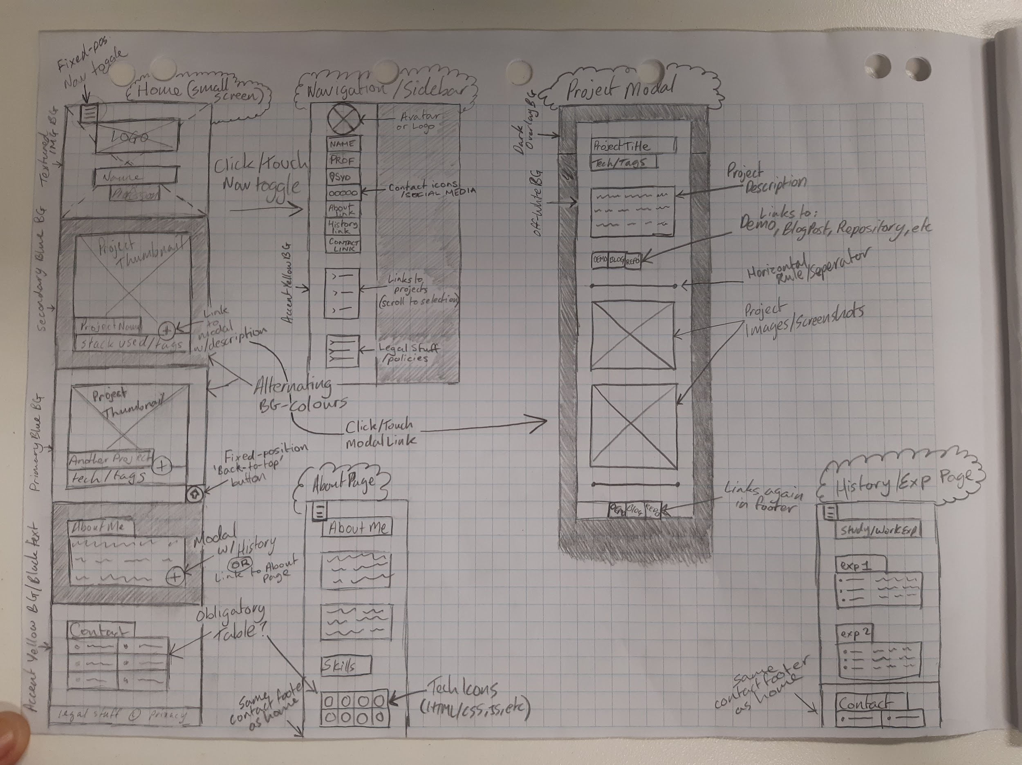
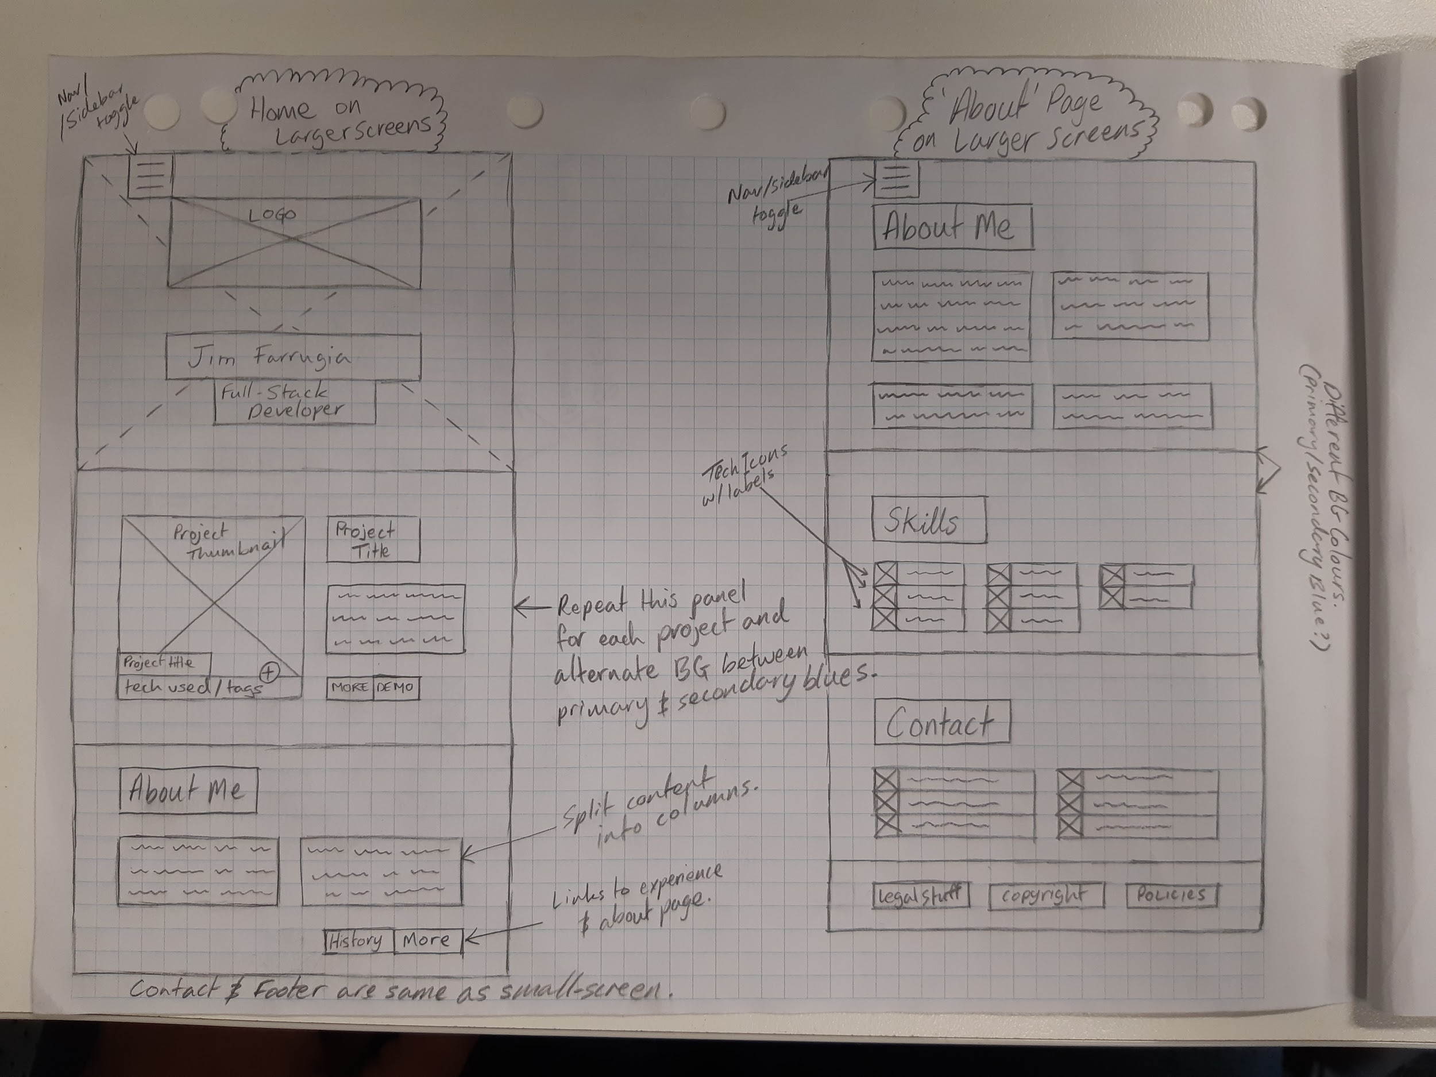
Wireframes

Slide 5
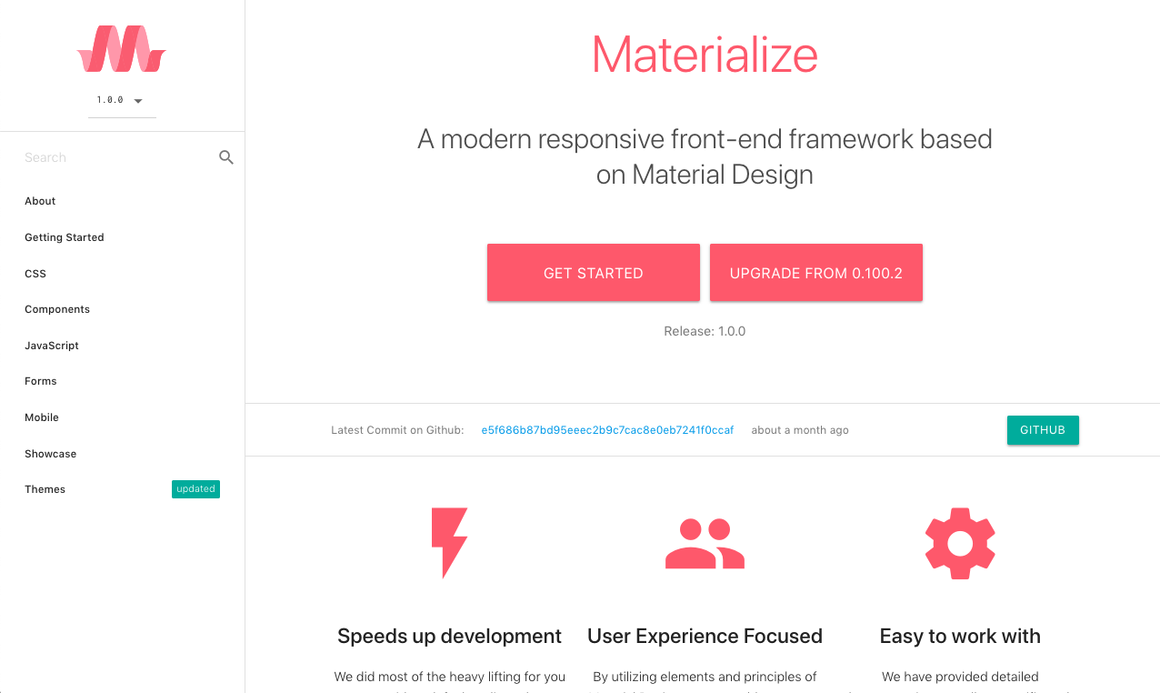
Materialize CSS
Modal Windows
Buttons
Responsive Grid
Sidebar
Animations
Much more...
Lots of examples in the docs:
https://materializecss.com/

Slide 6
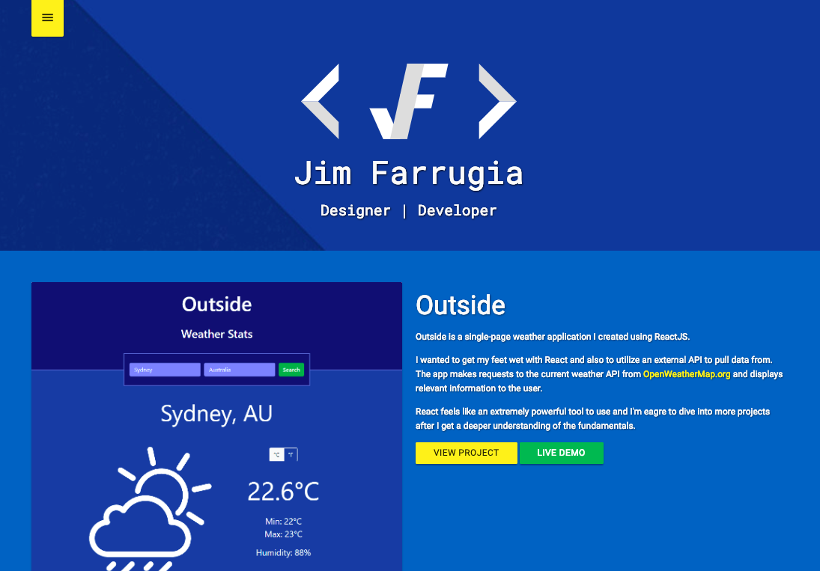
The Live Website
Walk-through portfolio.
https://jimfarrugia.github.io

Slide 7
Questions?
Thanks for your time.

